Slide 1



COMMUNICATION AND COLLABORATION ANALYSIS

Slide 2



Introduction
In today’s dynamic corporate environment, effective collaboration and satisfaction among team members are crucial for organizational success.
This Communication And Collaboration analysis project aims to provide a comprehensive overview of the key metric related to collaboration effectiveness, team support, and satisfaction within the organization.

Slide 3

Methodology used in the analysis
The analysis for this project was conducted using Survey Data. The following methodology was employed to ensure accurate and meaningful insights:
Survey Design:
Questionnaire Development: Created a comprehensive questionnaire covering key areas such as team collaboration, satisfaction, effectiveness, and support.
Pilot Testing: Conducted a pilot test to refine questions and ensure clarity and relevance.
Data Collection:
Distribution: Distributed the survey to employees across various departments and age groups using online survey tools.
Response Rate: Monitored response rates and sent reminders to ensure a representative sample.
Data Cleaning and Preparation:
Data Cleaning: Removed incomplete or inconsistent responses to maintain data quality.
Data Transformation: Standardized responses and created relevant metrics for analysis.
Descriptive Analytics:
Statistical Summaries: Calculated averages to summarize survey responses.
Visualization: Used bar graphs, line graphs, and pie charts, gauge, area chart to visually represent the data and identify patterns.
Data Visualization:
Dashboards: Created interactive dashboards using tools like Power BI to present the findings in an accessible and user-friendly manner.
Charts and Graphs: Included various types of visualizations to highlight key insights and trends.
Interpretation and Reporting:
Key Findings: Summarized the main findings from the survey analysis, highlighting significant patterns and trends.
Insights: Provided actionable insights based on the survey data, offering recommendations for improving team collaboration and satisfaction.

Slide 4
1. COMMUNICATION CHANNELS AND EFFECTIVENESS

Slide 5

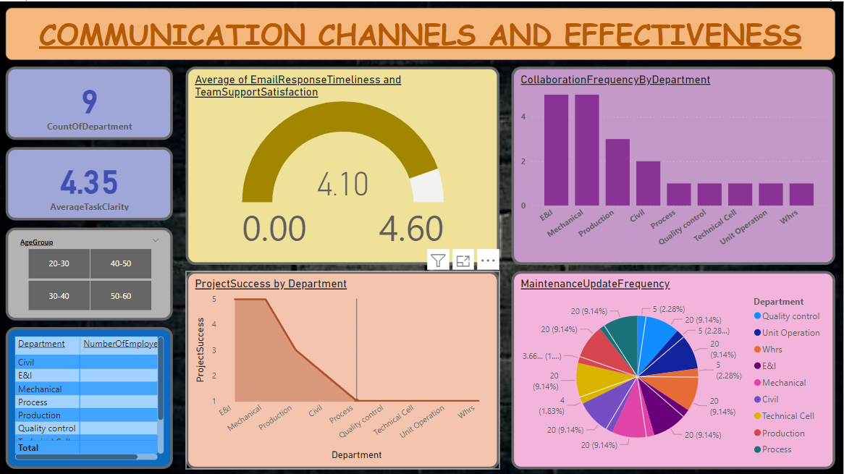

DASHBOARD

Slide 6
KEY INSIGHTS
Team Support:
Average score: 3.85/5
Indicates a generally supportive environment among team members
.
Team Effectiveness:
Average score: 4.10/5
Reflects strong overall team performance.
Supervisor Support:
Average score: 4.35/5
Suggests employees feel well-supported by their supervisors.
Generational Satisfaction:
Younger employees (20-29) are less satisfied compared to older groups.
Highlights potential areas for targeted improvement.
Age and Effectiveness:
Team Work Effectiveness decreases with age.
Indicates potential challenges in collaboration among older employees.
Interpersonal Respect:
Team Member Support scored highest among satisfaction metrics.
Implies strong interpersonal relationships and respect within teams.
Feedback Frequency:
Supervisor feedback frequency varies widely from ‘Never’ to ‘Daily.’
Could impact employee satisfaction and performance based on individual preferences.

Slide 7

2. COLLABORATION EFFECTIVENESS AND SATISFACTION

Slide 8

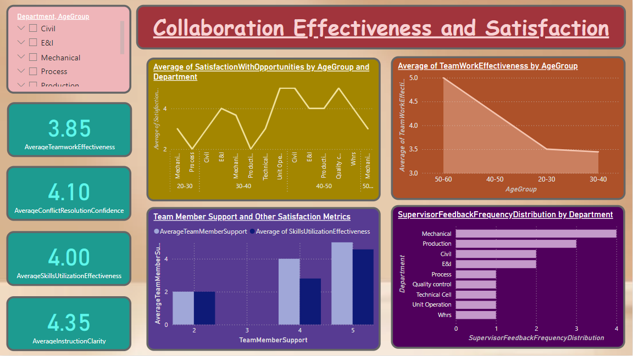
DASHBOARD

Slide 9

KEY INSIGHTS
Average Teamwork Effectiveness: 3.85, indicating a generally positive perception of teamwork effectiveness.
Satisfaction with Opportunities: While there are variations across age groups and departments, overall satisfaction with opportunities is moderate.
Team Member Support: A significant portion of respondents (42%) are satisfied with team member support.
Teamwork Effectiveness: Older age groups (50-60) show slightly higher levels of teamwork effectiveness compared to younger groups.
5. Satisfaction with Opportunities: The 30-40 age group appears to have the highest satisfaction with opportunities.
Supervisor Feedback Frequency: Production and Mechanical departments receive more frequent feedback from supervisors.
Conflict Resolution Confidence: The Civil department shows the highest average confidence in conflict resolution.
Skills Utilization Effectiveness: There are variations across departments, with Mechanical and Production departments showing higher levels of perceived skill utilization effectiveness.
Instruction Clarity: An average rating of 4.35 indicates generally clear instructions.
Conflict Resolution Confidence: The average of 4.10 suggests a moderate level of confidence in conflict resolution.

Slide 10

Conclusion
Communication Channels and Effectiveness:
The current communication channels generally support team satisfaction and task clarity.
However, there are variations across departments, suggesting a need for tailored strategies.
Regular monitoring and employee feedback are crucial for identifying areas for improvement.
Collaboration Effectiveness and Satisfaction:
There is room for improvement in teamwork effectiveness, particularly among younger age groups.
Enhancing opportunities for professional growth and development can increase employee satisfaction.
Tailored strategies are necessary to address departmental variations in collaboration and support.

Slide 11
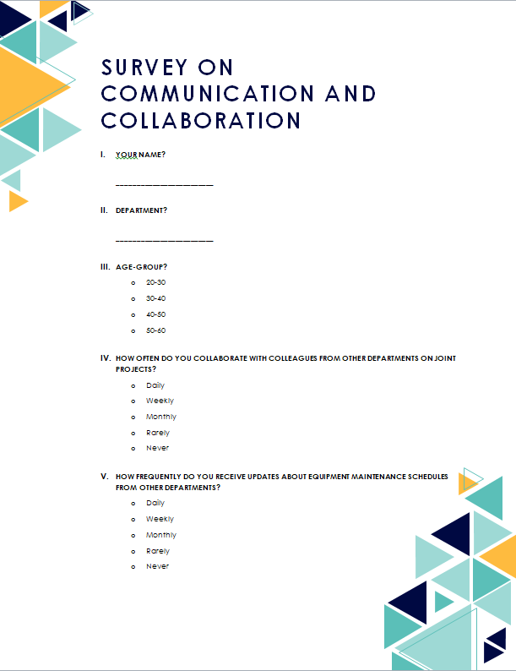
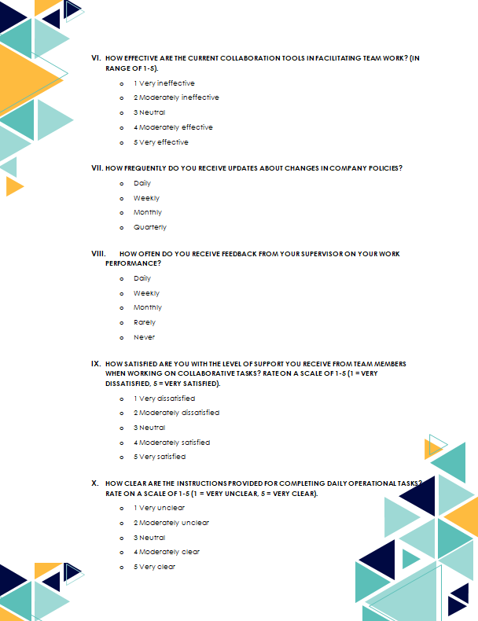
Survey Questionnaire

Slide 12
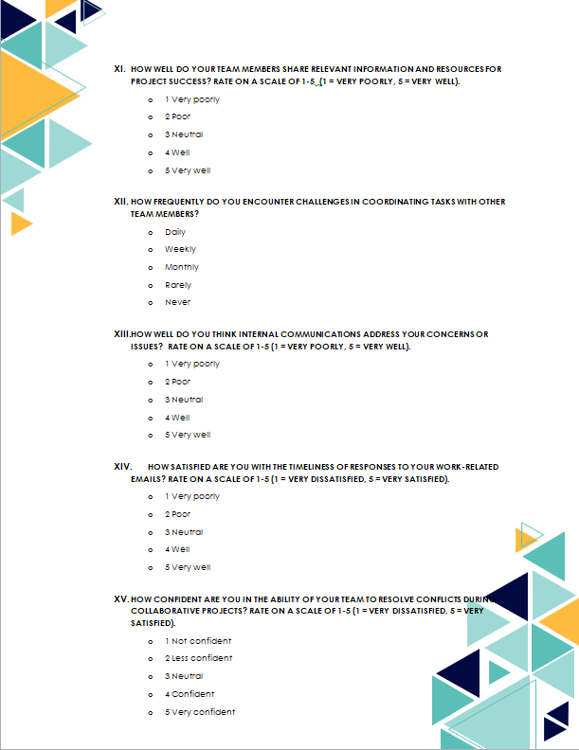
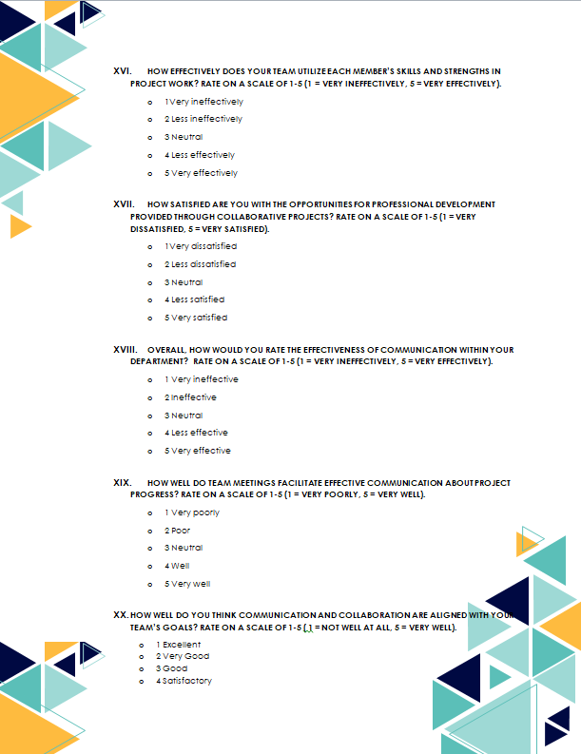
Survey Questionnaire

Slide 13
THANK YOU
SO MUCH!
Presented by ISHITA SHARMA

